Slide 1
Social Media System
Created by
P.Raj Saravanan,
CSE IIIRD YEAR,
Reg. no.:- 912320104034,
Sacs mavmm engineering college,
Madurai.

Slide 2
Project outline:
Problem statement
Proposed system /solution
System development approach
Algorithm and deployment
Result
Conclusion

Slide 3
Problem statement:
Develop a comprehensive solution to address the increasing concerns regarding privacy, misinformation, and cyberbullying on social media platforms. The solution should incorporate robust security measures, advanced algorithms for detecting and mitigating misinformation, and effective mechanisms for promoting positive online behavior and fostering a safe and inclusive online community.

Slide 4
Proposed system /solution:
One proposed solution for social media could involve implementing stronger user privacy controls, more transparent algorithms, and enhanced content moderation tools to mitigate harmful content. Additionally, fostering digital literacy programs to educate users about online safety and responsible sharing could help create a healthier social media environment.

Slide 5
Proposed system/solution (contd..)
User Feedback Mechanisms
User Privacy Controls
Content Moderation Tools
Digital Well-being Features
Community Guidelines and Enforcement
Educational Initiatives
Collaboration with Researchers and Experts
By implementing these components, the proposed social media system aims to create a safer, more transparent, and user-centric platform that fosters positive interactions and protects user privacy.

Slide 6
System development approach:
There are various system development approaches that can be used for social media platforms, depending on factors like project scope, requirements, timeline, and team expertise. Some common approaches include
Agile Development:
Waterfall Methodology
DevOps
Prototyping
Lean Development
RAD (Rapid Application Development):
The choice of development approach depends on factors like project complexity, budget, timeline, team size, and client preferences. Often, a hybrid approach may be adopted, combining elements from multiple methodologies to best suit the project's needs.

Slide 7
Algorithm and deployment:
Agile Development:
This approach emphasizes flexibility and iterative development. It involves breaking down the project into small, manageable tasks called sprints, with regular feedback and adaptation to changes.
Waterfall Methodology:
This traditional approach involves a linear, sequential process where each phase must be completed before moving to the next. It's less flexible than Agile but can be suitable for projects with well-defined requirements.
Lean Development:
Lean focuses on delivering value to the end-user while minimizing waste. It involves identifying and eliminating non-essential activities, optimizing processes, and prioritizing features based on user feedback and market demand. Proto

Slide 8
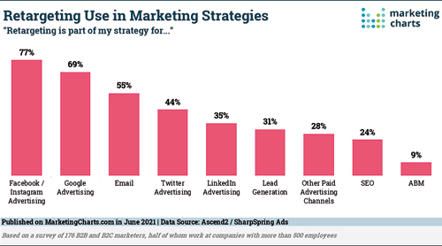
Result:
Figure: use in Marketing Strategies

Slide 9
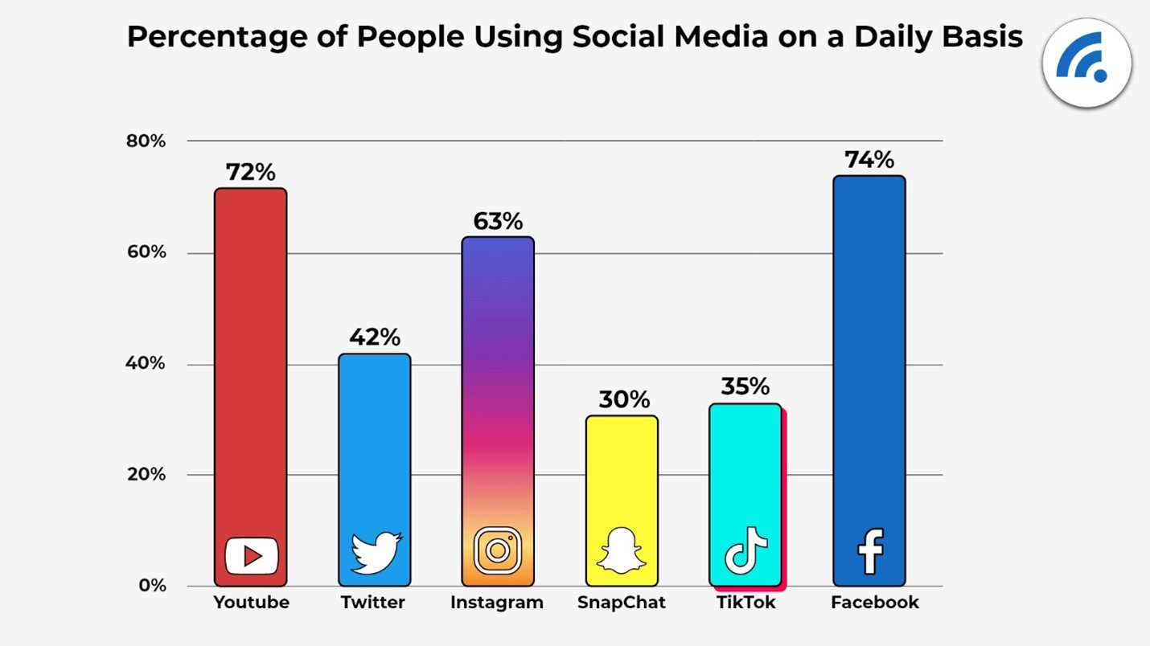
Result(Contd…)
Figure: Social media daily basis

Slide 10
Conclusion:
In conclusion, social media platforms rely heavily on sophisticated algorithms to drive user engagement, retention, and monetization. These algorithms play a crucial role in delivering personalized content, enhancing user experience, and fostering community growth.

Slide 11
THANK YOU

